Slide 1
Starter Activity -
Heat Beads and Ice Blocks Investigation

Slide 2
My Numbers and Operations Interactive Notebook
$$+$$
$$23$$
-1
$$−$$
$$×$$
$$÷$$
Name:
Class:
Teacher:
Semester 1
Term 1
$$5^{2}$$
$$0$$
$$−10$$

Slide 3

Interactive Notebooks!
Cover Page
Contents Page
Glossary
24/7/30
EQ
Questions
Notes
Summaries
Work page
Presentation!!!
Your book, your responsibility!

Slide 4


Slide 5
Contents
Glossary or Formula Page
Page
Date
Description
2
3

Slide 6

Learning Intentions
To learn a bit about the history of number systems✓
To further expand and solidify our mathematical vocabulary✓
To further learn the value of the place system ✓
To compare, order, add and subtract integers
WICOR

Slide 7
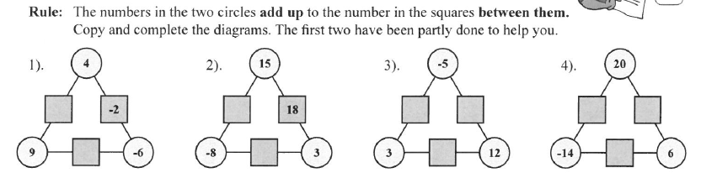
Topic : Worded Questions with integers
24
7
30
Date
EQ : What strategies can we use to answer worded questions?
While you are waiting……

Slide 8
24
7
30
Topic : Worded Questions with integers
Date
EQ : What strategies can we use to answer worded questions?
While you are waiting……
13
7
-2
7
6
26
3
-5
15
-8

Slide 9
24
7
30
Topic : Worded Questions with integers
Date
EQ : What strategies can we use to answer worded questions?
C - Circle the numbers in the question
U - Underline the question
B - Box the keywords
E - Eliminate the unnecessary information
S - Solve the question with working out
What is C.U.B.E.S?
Example
Jane spent $42 for shoes she also bought a new hat, sunglasses and a new shirt. This was $14 less than she spent for the new shirt. How much was the shirt?
42 = shirt - 14
42 + 14 = shirt
56 = shirt The shirt cost $56

Slide 10
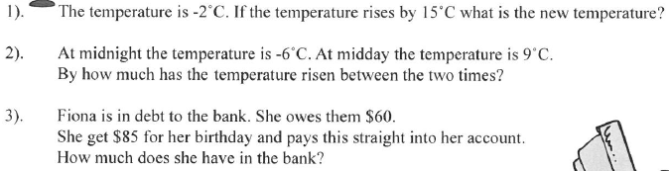
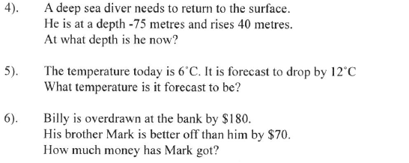

Slide 11
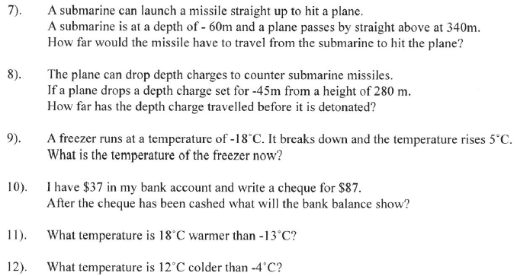

Slide 12
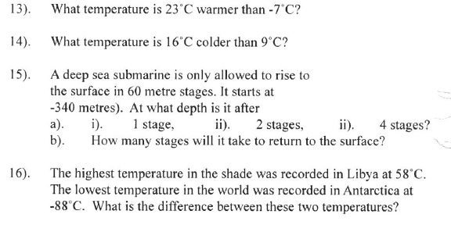

Slide 13

Do you understand? Fists of Five
Complete your Summary!
Notes:
Check for Understanding

